Slide 1
Relationship between feature films rating, genre, and active users (2015-2020)
Group Project – DATA422 Professors - Giulio Dalla Riva & Thomas Li
Data Wranglers : Sharmistha Dutta, Sanjay Chauhan, Prasoon Sharma, Mahesh Pandey, Anoop Murugan Krishnan

Slide 2


Agenda
Questions
Data Collection
Initial Data
Data Structuring and Cleaning
Data Wrangling
Results
Tools Used
Q&A

Slide 3
Questions
which genre is having more active users
Percentage of movies contribution as per genre
Directors who directed more than 10 movies
Years vs movies counts as per genre

Slide 4



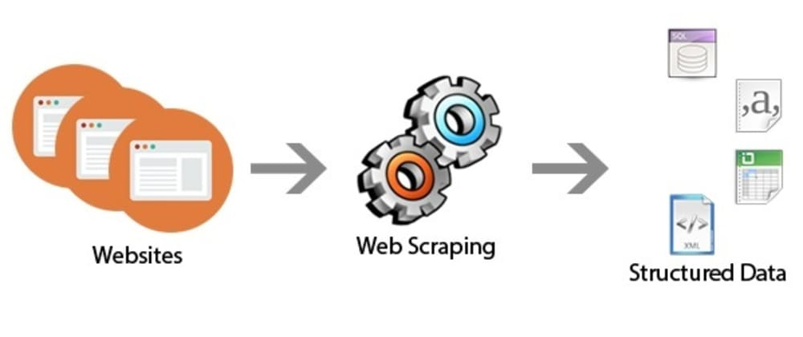
Data Collection

Slide 5
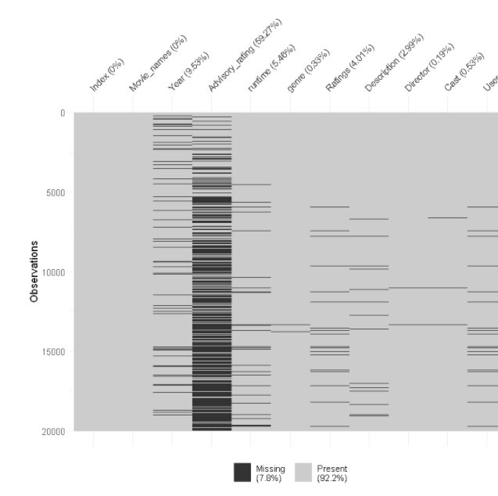
Initial Data
Unstructured
Unnecessary information

Slide 6
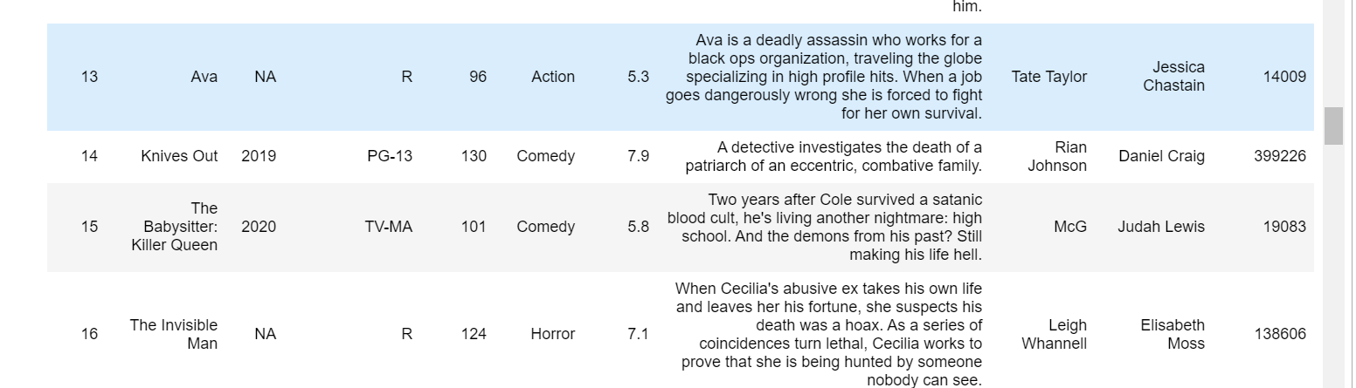
Initial Data
Year information

Slide 7
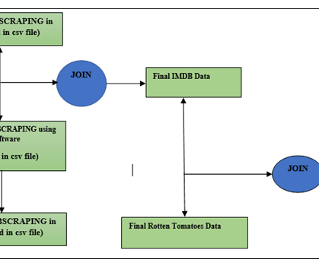

Data Structuring and Cleaning
Data collections in CSV
Creation of data frame
Cleaning of data
Joining of data frames

Slide 8
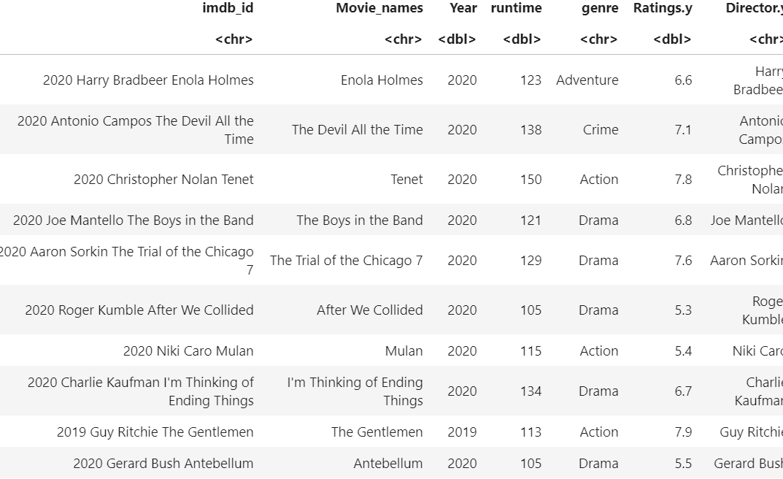
Data Structuring and Cleaning
CSV to data frame
Removal and replacement of NA’s
Removal of unwanted columns
Conversion of Data types
Joining of data frames using Id
Final Dataset

Slide 9
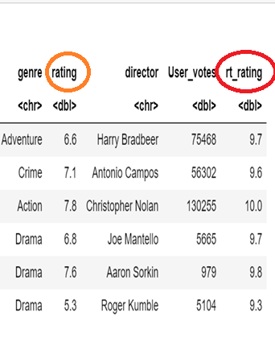
Data Structuring and Cleaning
Adding rotten tomatoes data as well to the data frame
Final Dataset

Slide 10
Data Wrangling
Summaries, max, sum
Gsub, Group by, arrange
Select, filter, join

Slide 11
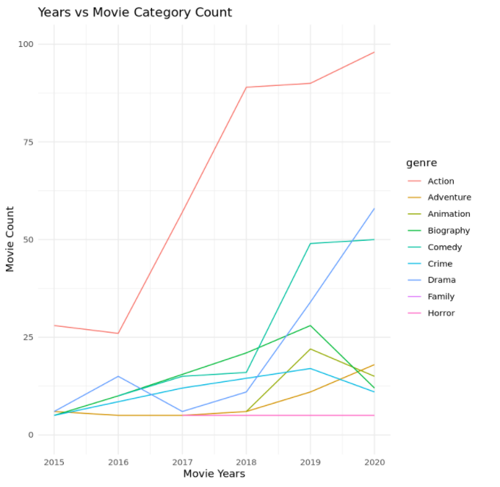
Results
Year vs Movie Count

Slide 12
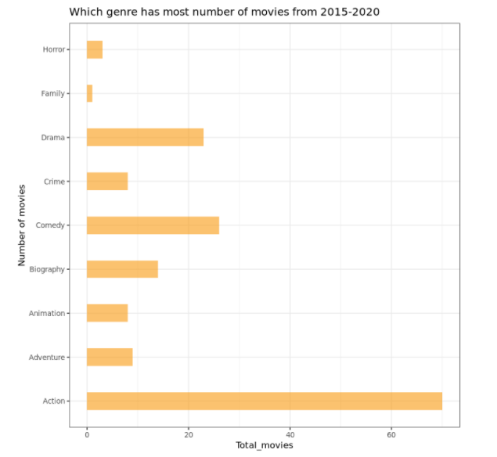
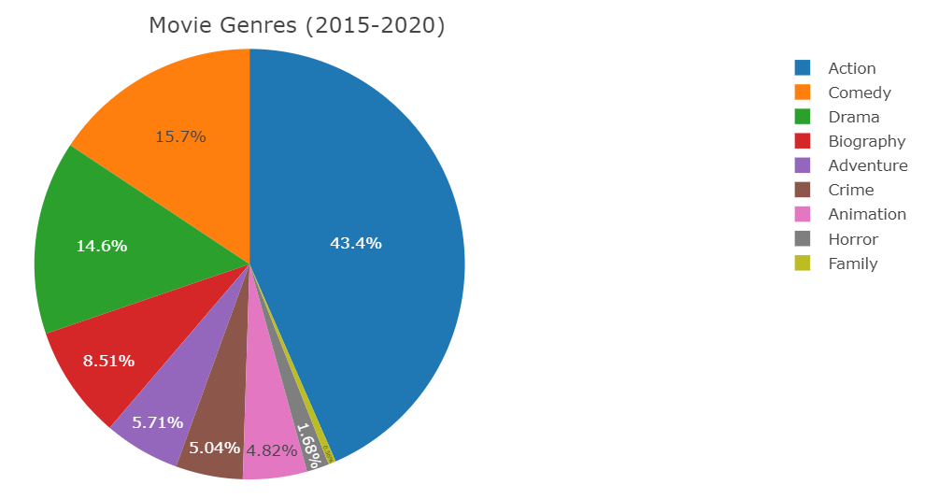
Results
Movie Contribution as per Genre

Slide 13
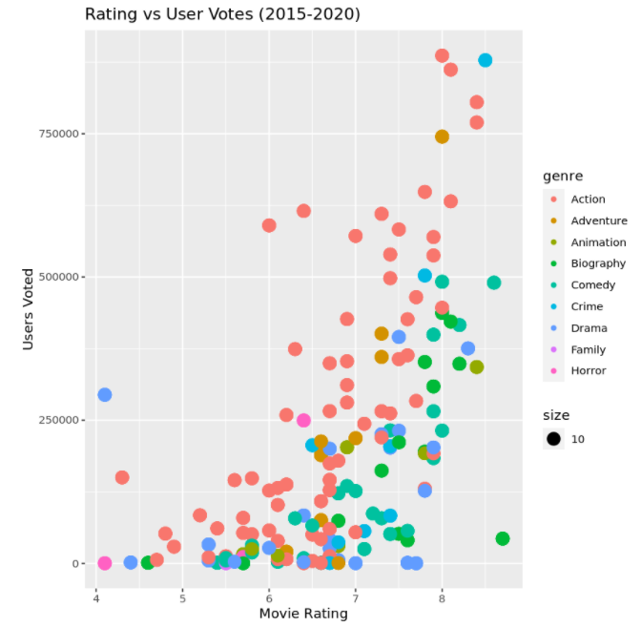
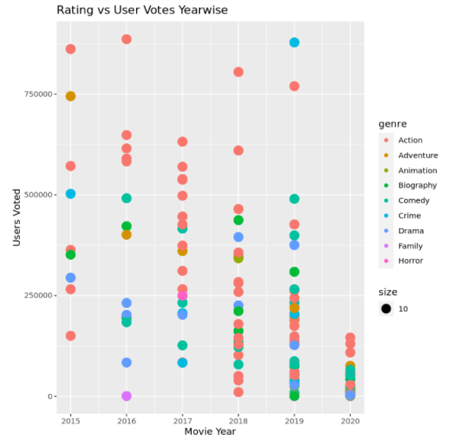
More Results
Rating vs User Votes
Rating vs User Votes as per year

Slide 14
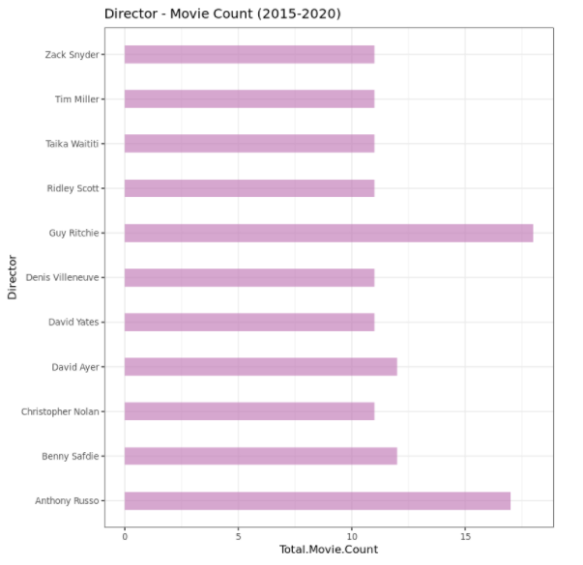
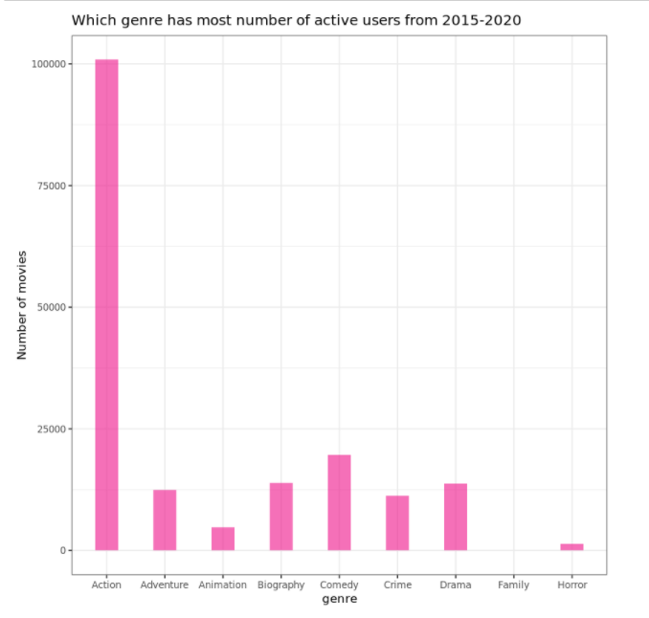
More Results
Director vs Movie Count
Genre vs Active Users

Slide 15
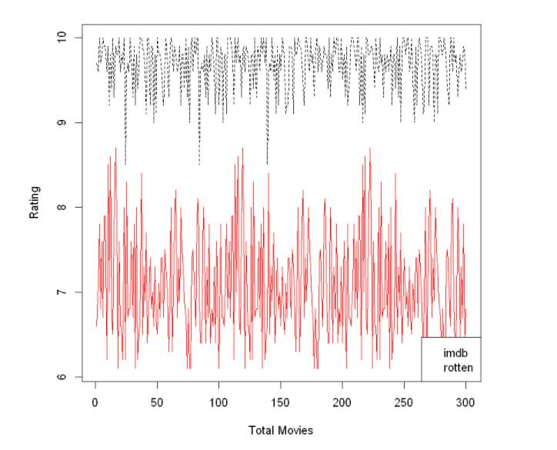
Rating Comparison
IMDB vs Rotten Tomatoes Rating Comparison in between 300 feature films

Slide 16
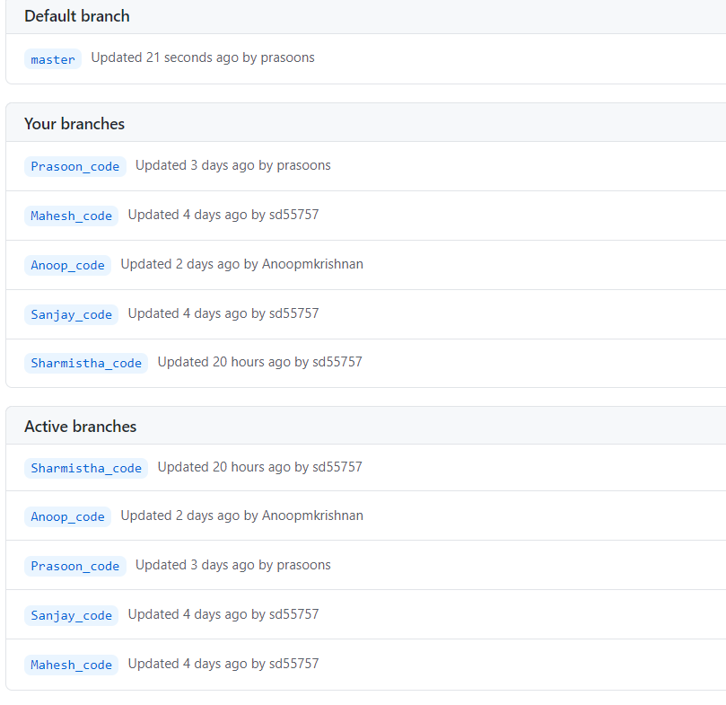
Tools Used
Jupyter Notebook
GitHub

Slide 17
Challenges
extraction of big amount of data
time management

Slide 18

Q&A

